Slide 1

NOIDA INSTITUTE OF ENGINEERING & TECHNOLOGY GREATER NOIDA
Course & Branch
Entrepreneurship Development & Intellectual Property Rights (AOE0771)
By
Alok Raj
Assistant Professor
MBA Department
NIET, GREATER NOIDA

Slide 2
Faculty Introduction
Faculty Name: Mr. Alok Raj
Designation : Assistant Professor
Department : MBA
Qualification :
MBA(Marketing and Operations)
Specialization : MBA(Marketing and Operations)
Teaching Area: General Management, Entrepreneurship, Operations Management
.
Subject: Entrepreneurship Development & Intellectual Property Rights By : Alok Raj

Slide 3
SYLLABUS

Slide 4
UNIT II
Introduction to Intellectual Property Rights
Intellectual Property and its protection
Various forms of protection as
Patents
Copyright
Trademark
Design knowhow
Trade secrets
Geographical Indications

Slide 5
Objective of the Unit
To know about the various forms of Intellectual Property Rights.
This will be helpful in protecting the original work and also give necessary understanding of how to gain financial benefits from it

Slide 6
COURSE OBJECTIVES
Explore the dimensions of creativity, innovation, and entrepreneurship
Develop an understanding of intellectual property rights
Be familiar with the financial support associated with new venture start-ups
Understand the various sources of idea generation and screening
Understand the policy framework for promoting entrepreneurship and providing finance to entrepreneurs.

Slide 7
Program Outcomes
PO1. Apply knowledge of management theories and practices to solve business problems.
PO2. Foster Analytical and critical thinking abilities for data-based decision making.
PO3. Ability to develop Value based Leadership ability.
PO4. Ability to understand, analyze and communicate global, economic, legal, and ethical aspects of business.
PO5. Ability to lead themselves and others in the achievement of organizational goals, contributing effectively to a team environment.

Slide 8
Program Educational Objectives
PEO1- Graduates of the management program will have conceptual knowledge to adapt to the rapidly changing environment, learn new skills and demonstrate application of management principles in professional work setting.
PEO 2- Graduates will apply appropriate tools for decision making required for solving complex managerial problems in the local or global context.
PEO 3-Graduates of the Management program will exhibit integrity, social responsibility, and teamwork.
PEO 4-Graduates will exhibit ethics, communication skills, leadership qualities and entrepreneurial mindset using creativity and innovation.

Slide 9
Prerequisite and Recap
ENTREPRENEURSHIP
THEORIES OF ENTREPRENEURSHIP
ROLE OF AN ENTREPRENEUR IN ECONOMIC DEVELOPMENT
QUALITIES OF AN ENTREPRENEUR
CLASSIFICATION OF ENTREPRENEURS
MOVITAVION THEORIES OF ENTREPRENEURSHIP
INTRAPRENEURSHIP

Slide 10
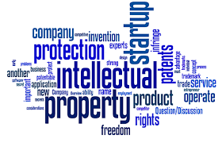
INTELLECTUAL PROPERTY RIGHTS (IPR)

Slide 11
INTELLECTUAL PROPERTY RIGHTS (IPR)
Intellectual property (IP) is a category of property that includes intangible creations of the human intellect.
Existed in societies such as Ancient Rome, modern concept developed in England in the 17th and 18th centuries.
The term "intellectual property" began to be used in the 19th century, though it was not until the late 20th century that intellectual property became commonplace in the majority of the world's legal systems.

Slide 12
INTELLECTUAL PROPERTY RIGHTS (IPR)
Intellectual property is any type of original creation, whether it is intellectual, artistic, or tangible. Almost anything you create is a piece of intellectual property: a song, a painting, an invention, a process, a novel, a movie, a recipe, a code— a logo.

Slide 13
INTELLECTUAL PROPERTY RIGHTS (IPR
The intangible nature of intellectual property presents difficulties when compared with traditional property like land or goods. Unlike traditional property, intellectual property is "indivisible", since an unlimited number of people can "consume" an intellectual good without it being depleted.
A landowner can surround their land with a robust fence and hire armed guards to protect it, but a producer of information or literature can usually do very little to stop their first buyer from replicating it and selling it at a lower price!!

Slide 14
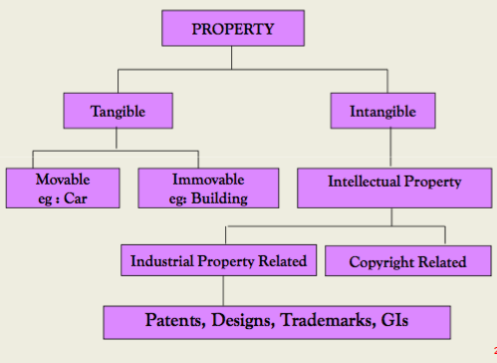
INTELLECTUAL PROPERTY RIGHTS

Slide 15
INTERNATIONAL ORGANIZATION, AGENCIES AND TREATIES
International trademark Association(INTA)
World Intellectual Property Organization(WIPO)
Berne Convention for the Protection of Literary and Artistic Works
Madrid Protocol
Paris Convention
North American Free Trade Agreement (NAFTA)
General Agreement on Tariffs and Trade (GATT)

Slide 16
PURPOSE OF IPR
The main purpose of intellectual property law is to encourage the creation of a wide variety of intellectual goods. To achieve this, the law gives people and businesses property rights to the information and intellectual goods they create, usually for a limited period of time.
This gives economic incentive for their creation, because it allows people to profit from the information and intellectual goods they create. These economic incentives are expected to stimulate innovation and contribute to the technological progress of countries, which depends on the extent of protection granted to innovators.

Slide 17
INTELLECTUAL PROPERTY AND ITS PROTECTION
Intellectual Property (IP) is the categorized representation of intangible things such as copyrights, patents, trademarks, unique concepts, and ideas. According to the rule of Intellectual Property, these intangible services should receive same legal protection just as the tangible property. In brief, it refers to the mere ownership of one’s ideas.
Creating a unique product for your business or bringing innovative ideas into reality can prove to be a priceless asset. Majority of the new entrepreneurs don’t recognize the need of protecting their Intellectual Property, and the ones who know are not aware of where to start.

Slide 18
INTELLECTUAL PROPERTY AND ITS PROTECTION
Keep it under scrutiny
Be aware of your Intellectual Property Rights
Consult an expert
Double check if your idea is unique
Hire an auditor
Keep a record of almost everything related
Protect your IP without delay

Slide 19
Forms of Protection depending on product
Case study:
https://www.inc.com/magazine/19820101/116.html
Patents
Copyrights
Trademarks
Trade secrets

Slide 20

PATENTS

Slide 21
PATENTS
A patent is a form of right granted by the government to an inventor or their successor-in-title, giving the owner the right to exclude others from making, using, selling, offering to sell, and importing an invention for a limited period of time, in exchange for the public disclosure of the invention for a definite geographical area.
Patents can be filed in India by the inventor at ipindia.nic.in
Term of patent is 20 years from the date of filing.

Slide 22
What is an example of a patent?
Inventions can be electrical, mechanical, or chemical in nature. Examples of inventions protected by utility patents are a microwave oven, genetically engineered bacteria for cleaning up oil spills, a computerized method of running cash management accounts, and a method for curing rubber.

Slide 23
PATENTS
In India , Patents rights are governed by the Patents Act, 1970. at present 3rd Amendment of act known as the patent(amendment ) act, 2005 is in force.
For application of patents act, rules made by the government, known as “Patent Rules, 2003”, Patent(amendment) rule updated in sept. 2015 is in force.

Slide 24
PATENTS
HDFonoDoc – Invented by Arvind Thiagarajan, HDFonoDoc is a trailblazing handy device, which can detect murmur in the heart within 10 seconds. This 37-year-old inventor was honored with Junior Scientist Award in 2001. He is a prolific entrepreneur and founder of several Medical diagnostic start-ups who has over 40 patents under his name.
Washing system with high-pressure water jets for cleaning tubes of heat recovery steam generator – Invented by the R&D sector of Bharat Heavy Electricals Limited (BHEL), the invention particularly relates to a system used for removing ash deposits formed on the spiral finned tubes of a heat recovery steam generator. Ranked by Forbes as the 9th most innovative company in the world, BHEL files one patent a day and is accredited to be the Indian company that holds the most number of patents.

Slide 25
PATENTS
Pen with scanner. With a machine as small as a pen, you can transfer text from paper directly into a computer.
System for shorter flight times.
The blood rocker.
Packaging success.
Life-saving invention.

Slide 26
What are some examples of copyright works?
A novel.
A poem.
A photograph.
A movie.
Lyrics to a song.
A musical composition in the form of sheet music.
A sound recording.
A painting.

Slide 27
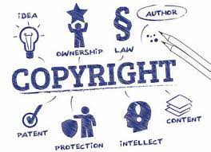
COPYRIGHT

Slide 28
COPYRIGHTS
A copyright gives the creator of an original work exclusive rights to it, usually for a limited time.
Copyright may apply to a wide range of creative, intellectual, or artistic forms, or "works".
Copyright comes into existence as soon as the work is created and protects skill and labour employed by the creator on production of the work.

Slide 29
COPYRIGHTS
Literary works as novels, poems, plays, reference works, newspapers, articles.
Computer programs and databases.
Films, musical compositions, dance and theatrical productions
Artistic works as paintings, drawings, photographs and sculptures.
Architecture, advertisements, maps, technical drawings, manuals, etc.
Copyright does not cover ideas and information themselves, only the form or manner in which they are expressed.

Slide 30
Rights granted by Copyright
Copyright grants certain rights that are exclusive to its owner. Based on these rights, the copyright owner
• Can copy the work
• Issue copies of the work to the public
• Rent or lend the work to the public
• Perform, show or play the work in public
• Communicate the work to the public – this includes broadcasting of a work and also electronic transmission and make an adaptation of the work or do any of the above in relation to an adaptation.

Slide 31
IMPORTANCE OF COPYRIGHT
It gives exclusive rights to the owner of original work to reproduce, duplicate, transcribe, and translate the work.
The owner can prevent the misuse of their original work and can take legal action if infringement takes place.
The owner has the sole right to get monetary benefits from their work.
Encourages society for creativity as owners enjoy the benefits and protection of their creative work.

Slide 32
Quiz
What are IPR
What is the importance of IPR
How are IPR different from property rights
What are the various forms of IPR
Discuss patents with an example
What is copyright, give suitable examples

Slide 33
PRECAP
What are IPR
What is the importance of IPR
How are IPR different from property rights
What are the various forms of IPR
Discuss patents with an example
What is copyright, give suitable examples

Slide 34
SESSION OBJECTIVE (CO2)
To give students the insights into what are other types
of intellectual property rights as trademarks,
trade secrets, industrial design rights and plant varieties.

Slide 35
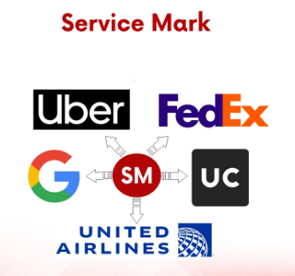
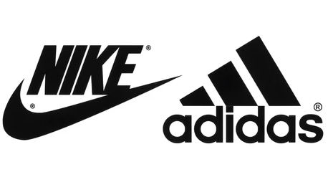
TYPES OF MARKS
Trademark: Example : Nike, Bata etc
2. Service mark: Examples of service marks are Hawaiian Airlines, Google, FedEx, Uber, United Airlines etc.

Slide 36
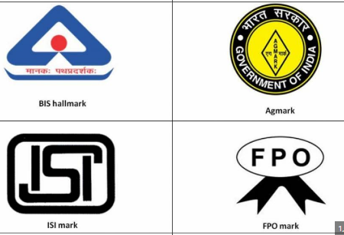
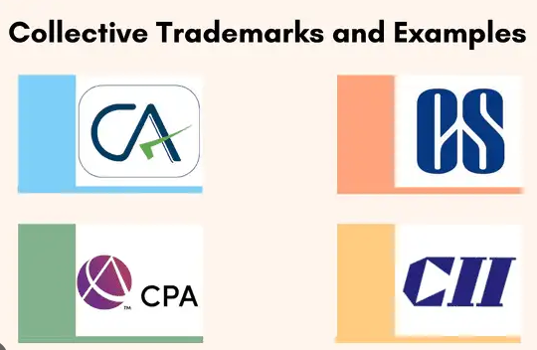
TYPES OF MARKS
3. Certification mark : Hallmark, ISO, ISI, AGMARK, FPO Mark etc.
4. Collective mark :
Collective membership organization, such as a labor union, fraternity, or professional society.

Slide 37
TYPES OF MARKS
Brand names like Apple, McDonald's, and Dolce & Gabbana.
Product names like iPod and Big Mac.
Company logos like the golden arches at McDonald's and NBC's peacock logo.
Slogans like Capital One's "What's in your wallet?" and McDonald's "I'm lovin' it"

Slide 38
Trademark
A trademark protects intellectual property from theft or infringement. A trademark can be utilized for a name, title, logo, or symbol representing a business. Because so much time and money is invested into developing your company's logo, it is crucial to secure it.
A company logo is a visual representation of your brand. The logo is how consumers recognize your business, so trademarking it is vital in protecting its reputation as something that is yours and yours alone. If an entity were to copy your logo for another brand, that would be cause for confusion and a significant credibility hit.

Slide 39
Having a trademark enables a brand owner to prevent others from copying its brand name and from confusing the public about the source of the particular goods and services.
Not only do trademarks prevent someone from adopting an identical match, but can also sometimes prevent someone from adopting a confusingly similar trademark. For example, Starbucks took Sadarbuksh in India to court over an allegedly similar logo:

Slide 40
There is a whole body of law about what can and can’t be trademarked, but one of the most common misconceptions is that you can trademark a generic or descriptive term.
For example, you can’t trademark APPLE for a brand of apples (the fruit), because that would be unfair since it would effectively remove a common generic word from usage by the public.
However, you can of course trademark APPLE for computers, because APPLE is not the generic or descriptive term for computers.

Slide 41
TRADEMARKS
Brand names like Apple, McDonald's, and Dolce & Gabbana.
Product names like iPod and Big Mac.
Company logos like the golden arches at McDonald's and NBC's peacock logo.
Slogans like Capital One's "What's in your wallet?" and McDonald's "I'm lovin' it"

Slide 42
Types of trademarks include:
Google's trademark--now the most valuable on the planet, according to Brand Finance--is worth an estimated $44 billion, or 27% of the firm's overall value,
Microsoft - Trademark value: $42.8 billion
Apple, McDonald's, and Dolce & Gabbana.
Product names like iPod and Big Mac.
Company logos like the golden arches at McDonald's and NBC's peacock logo.
Slogans like Capital One's "What's in your wallet?" and McDonald's "I'm lovin' it"

Slide 43
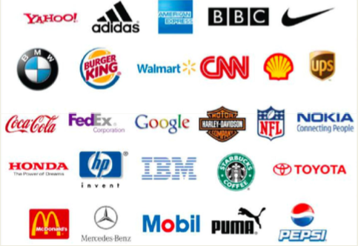
TRADEMARKS

Slide 44
TRADEMARKS
The first landmark judgment on cybersquatting.
The Delhi High Court, for the first time ever in India, held that a domain name serves the same function as trademark and is entitled to equal protection. The defendant had a domain name ‘Yahoo India!’ which was identical and phonetically similar to the plaintiff’s trademark ‘Yahoo!’.
The court held that internet users would be confused and deceived into believing that both the domain names have the same source. The defendant took a defense that it had put a disclaimer on its website. However, it was observed that a mere disclaimer was not sufficient because the nature of the internet is such that use of a similar domain name cannot be rectified by a disclaimer and it does not matter that ‘yahoo’ is a dictionary word. The name possesses acquired distinctiveness and uniqueness and was largely associated with the plaintiff.

Slide 45
TRADEMARKS
Another cyber-squatting issue where the Academy Awards was headed up against the domain retailer GoDaddy. It was a battle that lasted for five years. Initially, in 2010, it was filed by Academy alleging GoDaddy’s decision to let customers buy “confusingly” similar domain names like 2011Oscars.com, etc. It claimed on allowing individuals to pass on the profits who wanted to “park” on these domains and claimed a part of revenue.
The Academy demonstrated to the court that there were 57 domains sold by GoDaddy that were termed as ‘potentially confusing’. But, in the end, the judge ruled that GoDaddy had no “requisite bad faith intent to profit” from their domain sales.
The legal battle between these two big brands lasted 5 years and was deemed as an expensive affair. While this legal battle was undoubtedly expensive, it went in favor of the cybersquatting space and GoDaddy came out clean.

Slide 46
TRADEMARKS
Cadila Health Care v. Cadila Pharmaceutical Ltd.
The Supreme Court held that it is insignificant whether the plaintiff and the defendant trade in the same field or in the same or similar products.
The court laid down certain criteria to determine passing off of an unregistered trademark: • The nature of the marks (word, label or composite); • The degree of resemblance between the marks;/ • The nature of goods for which the marks are used; • Similarities in the nature, character and performance of goods of rival traders; • The class of purchasers who are likely to buy goods bearing the marks; • The method of purchasing the goods or placing orders; and • Other circumstances that may be relevant.

Slide 47
TRADEMARK
Zara Food vs Zara Fashion Another case of food industry vs fashion for the brand name – Zara. It is a renowned fashion brand having major operations across the world found a restaurant operating in Delhi under the same name. It is highly possible that any consumer would confuse one for the other and take into consideration that the restaurant was started by the fashion brand.
And this what Delhi High Court ruled out. Zara had a presence in India since 2010 when it opened its first store through a joint venture and has also applied for a few trademarks in India. The restaurant was forced to change its name and now it operates under the name of Tapas Bar.

Slide 48
Most Valuable Trademarks in the World
Amazon – 416 Billion Dollars.
Apple – 352 Billion Dollars.
Microsoft – 327 Billion Dollars.
Google – 324 Billion Dollars.
Visa – 187 Billion Dollars.
Alibaba – 153 Billion Dollars.
Tencent – 151 Billion Dollars.
Facebook – 147 Billion Dollars.

Slide 49
RECAP AND QUIZ
Define IPR.
Define copyright.
Write the full form of IPR
Explain the importance of IPR in current scenario.

Slide 50
PRECAP
Trade mark
Definition of IPR
Basic knowledge of Copyright

Slide 51
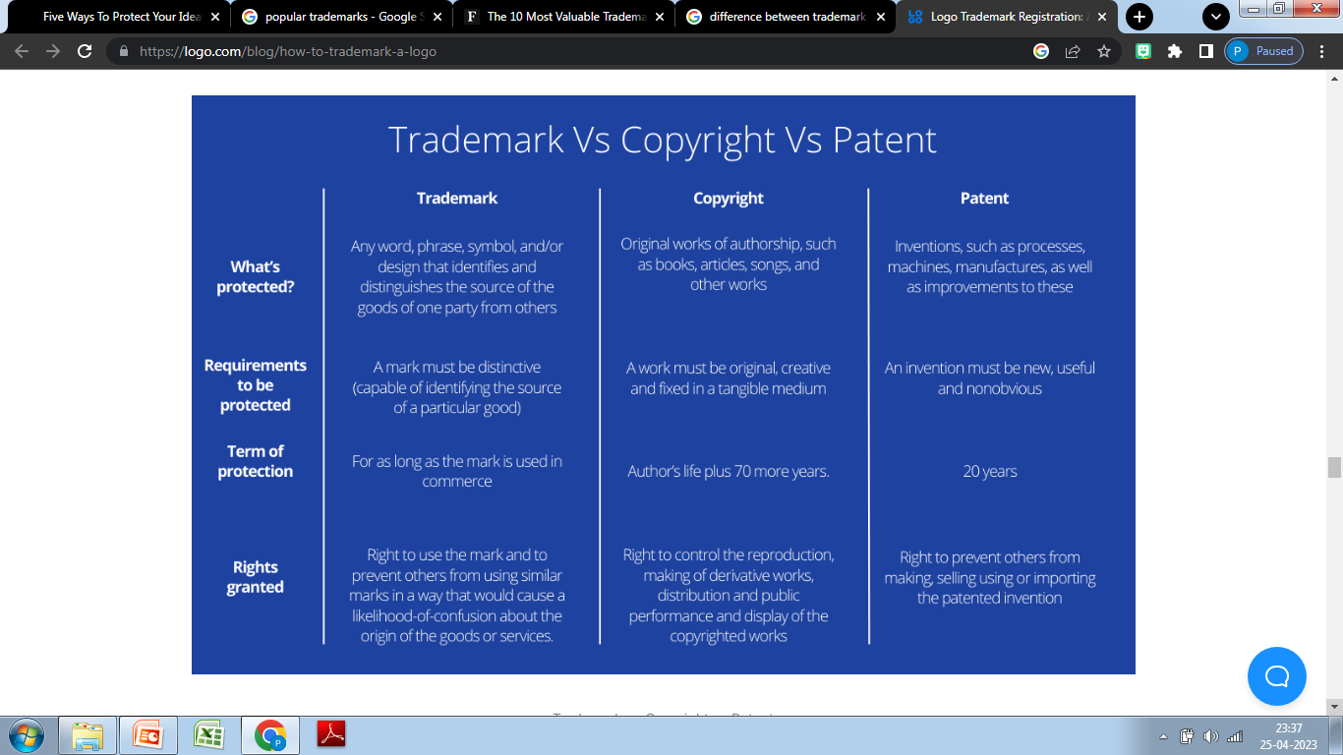
RECAP

Slide 52
RECAP AND QUIZ
What are IPR
What is the importance of IPR
How are IPR different from property rights
What are the various forms of IPR
Discuss patents with an example
What is copyright, give suitable examples

Slide 53
PRECAP
What are IPR
What is the importance of IPR
How are IPR different from property rights
What are the various forms of IPR
Discuss patents with an example
What is copyright, give suitable examples

Slide 54
SESSION OBJECTIVE (CO2)
To give students the insights into what are other types
of intellectual property rights as trademarks,
trade secrets, industrial design rights and plant varieties.

Slide 55
INDUSTRIAL DESIGN RIGHTS
An industrial design consists of the creation of a shape, configuration or composition of pattern or color, or combination of pattern and color in three-dimensional form containing aesthetic/ornamental aspects.
An industrial design can be a two- or three-dimensional pattern used to produce a product, industrial commodity or handicraft. Generally speaking, it is what makes a product look appealing, and as such, it increases the commercial value of goods.

Slide 56
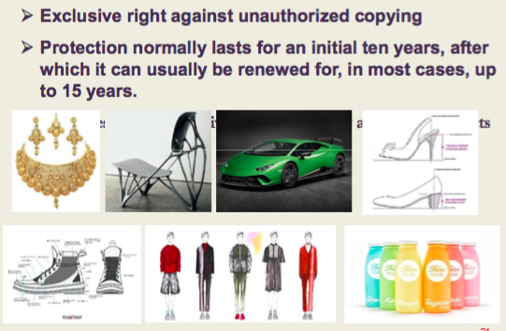
INDUSTRIAL DESIGN RIGHTS

Slide 57
INDUSTRIAL DESIGN RIGHTS
An industrial design consists of the creation of a shape, configuration or composition of pattern or color, or combination of pattern and color in three-dimensional form containing aesthetic/ornamental aspects.
An industrial design can be a two- or three-dimensional pattern used to produce a product, industrial commodity or handicraft. Generally speaking, it is what makes a product look appealing, and as such, it increases the commercial value of goods.

Slide 58
RECAP AND QUIZ
What are trademarks?
Define trade secrets with suitable examples?
Where can industrial design rights be used explain with examples
what are plant varieties and where are they used?

Slide 59
SESSION OBJECTIVE (CO2)
To understand about trade dress and GI tag.
Trying to list the various geographical Indications
Accorded across India.

Slide 60
TRADE SECRETS
The other common law protection, trade secrets, may be defined as all those documents and pieces of information within a company that the company takes steps to conceal from outsiders and that are not necessarily disclosed upon the sale of the company's product or services.
Examples include customer lists, blueprints, and recipes.
However, maintaining secrecy is essential; a company cannot prevent an outsider from using the secret if the company voluntarily or carelessly revealed it to him without a signed agreement prohibiting use of these materials.
The company also cannot prevent outsiders from using its trade secret if the outsider arrived at it independently. (A patent, remember, does allow a company to stop such use.)
KFC's secret blend of 11 herbs and spices.
Coca-Cola's recipe for their signature drink.
Google's search algorithm.
McDonald's Big Mac “special sauce.”
Secret client lists at any company.

Slide 61
GEOGRAPHICAL INDICATIONS
GI (Geographical Indication) tag identify agricultural, natural or manufactured goods associated with territory/region/locality.
GI gives protection to the group of people or association involved in the production of the product using traditional skills and knowledge.
The concept of GI tag was introduced in the year 2013 and it was given to foods, natural and agricultural produce and handicrafts that gave a region it’s identity. The tags were given under the act of Geographical Indications of Goods (Registration and Protection) Act,1999.

Slide 62
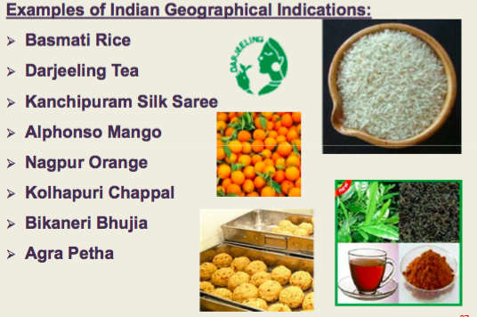
GEOGRAPHICAL INDICATIONS

Slide 63
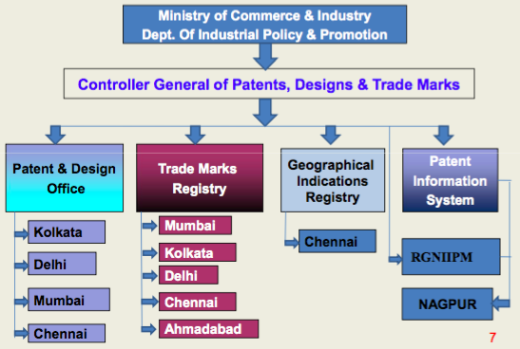
ORGANIZATION STRUCTURE

Slide 64
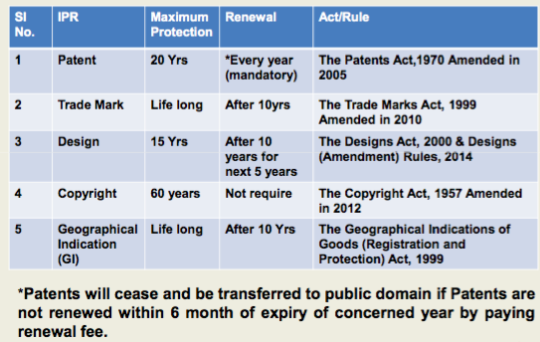
VALIDITY OF IPR

Slide 65
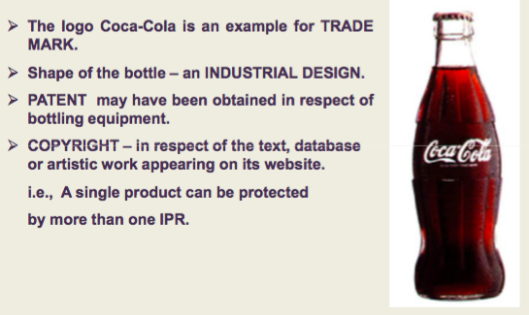
EXAMPLES OF IPR

Slide 66
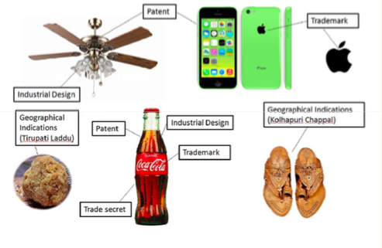
EXAMPLES OF IPR

Slide 67
Video Link
https://www.youtube.com/watch?v=KV3HarFV2kQ
https://www.youtube.com/watch?v=WvduZOWoft0
https://www.youtube.comwatchv=5fvpsqPWZac&list=PLyqSpQzTE6M8PuzP1p2hNPXgpbOBhFgja&index=1
https://www.youtube.com/watch?v=qGPwcm4yAAs
https://www.youtube.com/watch?v=qKXB5nuZ7Cs

Slide 68
Quiz
Q1. What do you understand by IPR?
Q2. why are Intellectual Property Rights important?
Q3. State and describe the various forms of IPR?
Q4. Discuss the inportance of copyrights.
Q5. what is a GI tag?

Slide 69
MCQs
1. Intellectual Property Rights (IPR) protect the use of information and ideas that are of
Ethical value
Moral value
Social value
Commercial value
2. The term ‘Intellectual Property Rights’ covers
Copyrights
b. Know-how
c. Trade dress
d. All of the above
3. The following can be patented
a. Machine
b. Process
c. Composition of matter
d. All of the above

Slide 70
MCQs
4. Trade mark
is represented graphically
is capable of distinguishing the goods or services of one person from those of others
may include shapes of goods or combination of colours
All of the above
5. Symbol of Maharaja of Air India is
Copyright
Patent
Trademark
All of the above
6. In India, the literary work is protected until
Lifetime of author
25 years after the death of author
40 years after the death of author
60 years after the death of author

Slide 71
Assignment
Describe Intellectual Property Rights. CO2
What is the importance of IPR. CO2
Discuss the various forms if IPR. CO2

Slide 72
Old Question Papers
https://abesit.in/library/download/MBA/Sem.3/2014-15/Entrepreneurship%20Development%20(NMBA-031,MBT%20M-031).pdf
https://abesit.in/library/download/MBA/Sem.3/2014-15/Entrepreneurship%20Development%20(NMBA-031,MBT%20M-031).pdf

Slide 73
Expected Questions
What are patents explain with suitable examples?
Why is IPR important for an organization. Explain the concept and usefulness of IPR for a nation.
Define geographical indications?
What are the various forms of IPR.

Slide 74
Summary
This unit gives a clear picture of Intellectual Property Rights. It also tells how we can make use of these rights. Why these rights are important for an organization.
The various forms available for taking intellectual property rights.

Slide 75
Summary
This unit gives a clear picture of Intellectual Property Rights. It also tells how we can make use of these rights. Why these rights are important for an organization.
The various forms available for taking intellectual property rights.

Slide 76
THANKYOU

